Slide 1

Support Vector Machine
Franz Andersch & Niklas Münz

Slide 2
Introduction

Slide 3
Basic idea of Support Vector Machine
Especially effective in classification (also used for regression)
Find the hyperplane that separates classes with the maximum possible margin
Only the support vectors (datapoints closest to hyperplane) have direct influence on the position of the hyperplane

Slide 4
History of Support Vector Machine
Early ideas of a seperating Hyperplane 1936 (R. Fisher)
First SVM algorithm in 1964 (V. Vapnik, A. Chervonenkis)
Use of kernel trick for nonlinear classifiers in 1992 (B. Boser, I. Guyon, V. Vapnik)
Introduction of „soft margin“ in 1995 (C. Cortes, V. Vapnik)

Slide 5
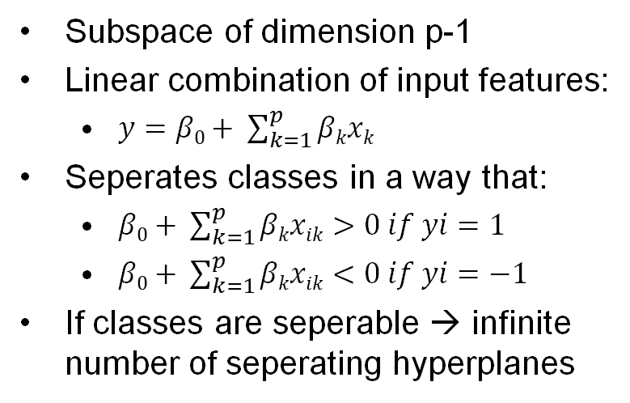
How it works: Seperating Hyperplane
Subspace of dimension p-1
Linear combination of input features:
$y=β0+ \sum_{k=1}^{p}{βkxk}$
Seperates classes in a way that:
$β0+ \sum_{k=1}^{p}{βkxik}>0 if yi=1$
$β0+ \sum_{k=1}^{p}{βkxik}<0 if yi=−1$
If classes are seperable → infinite number of seperating hyperplanes
Grafik

Slide 6
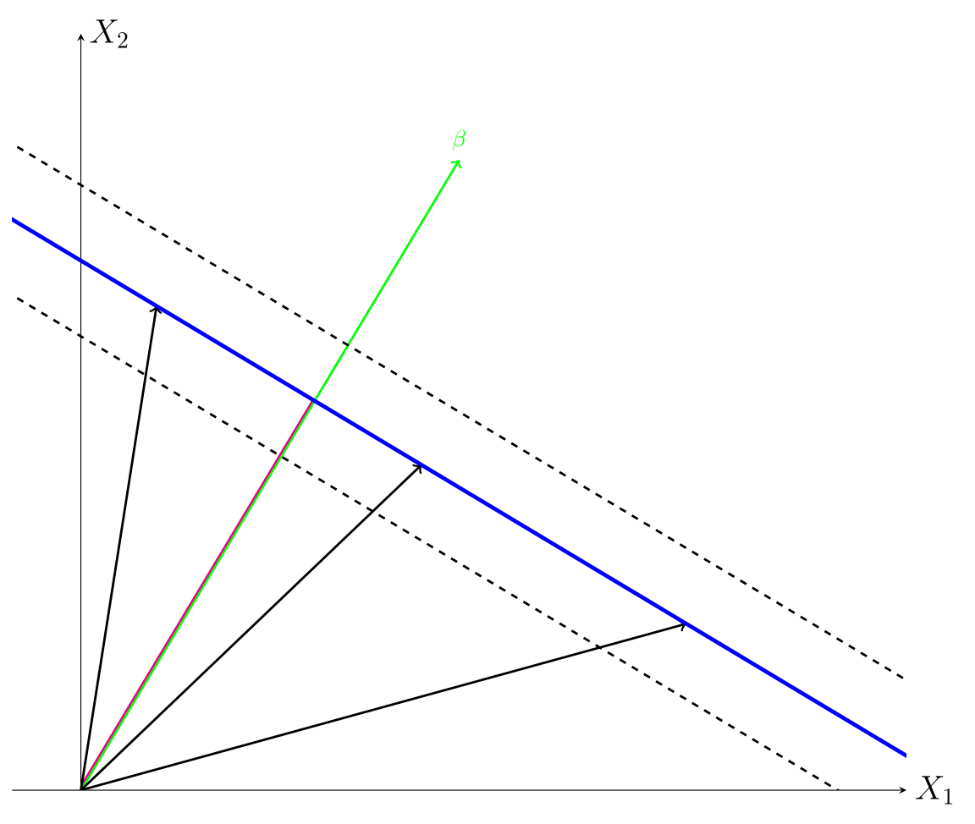
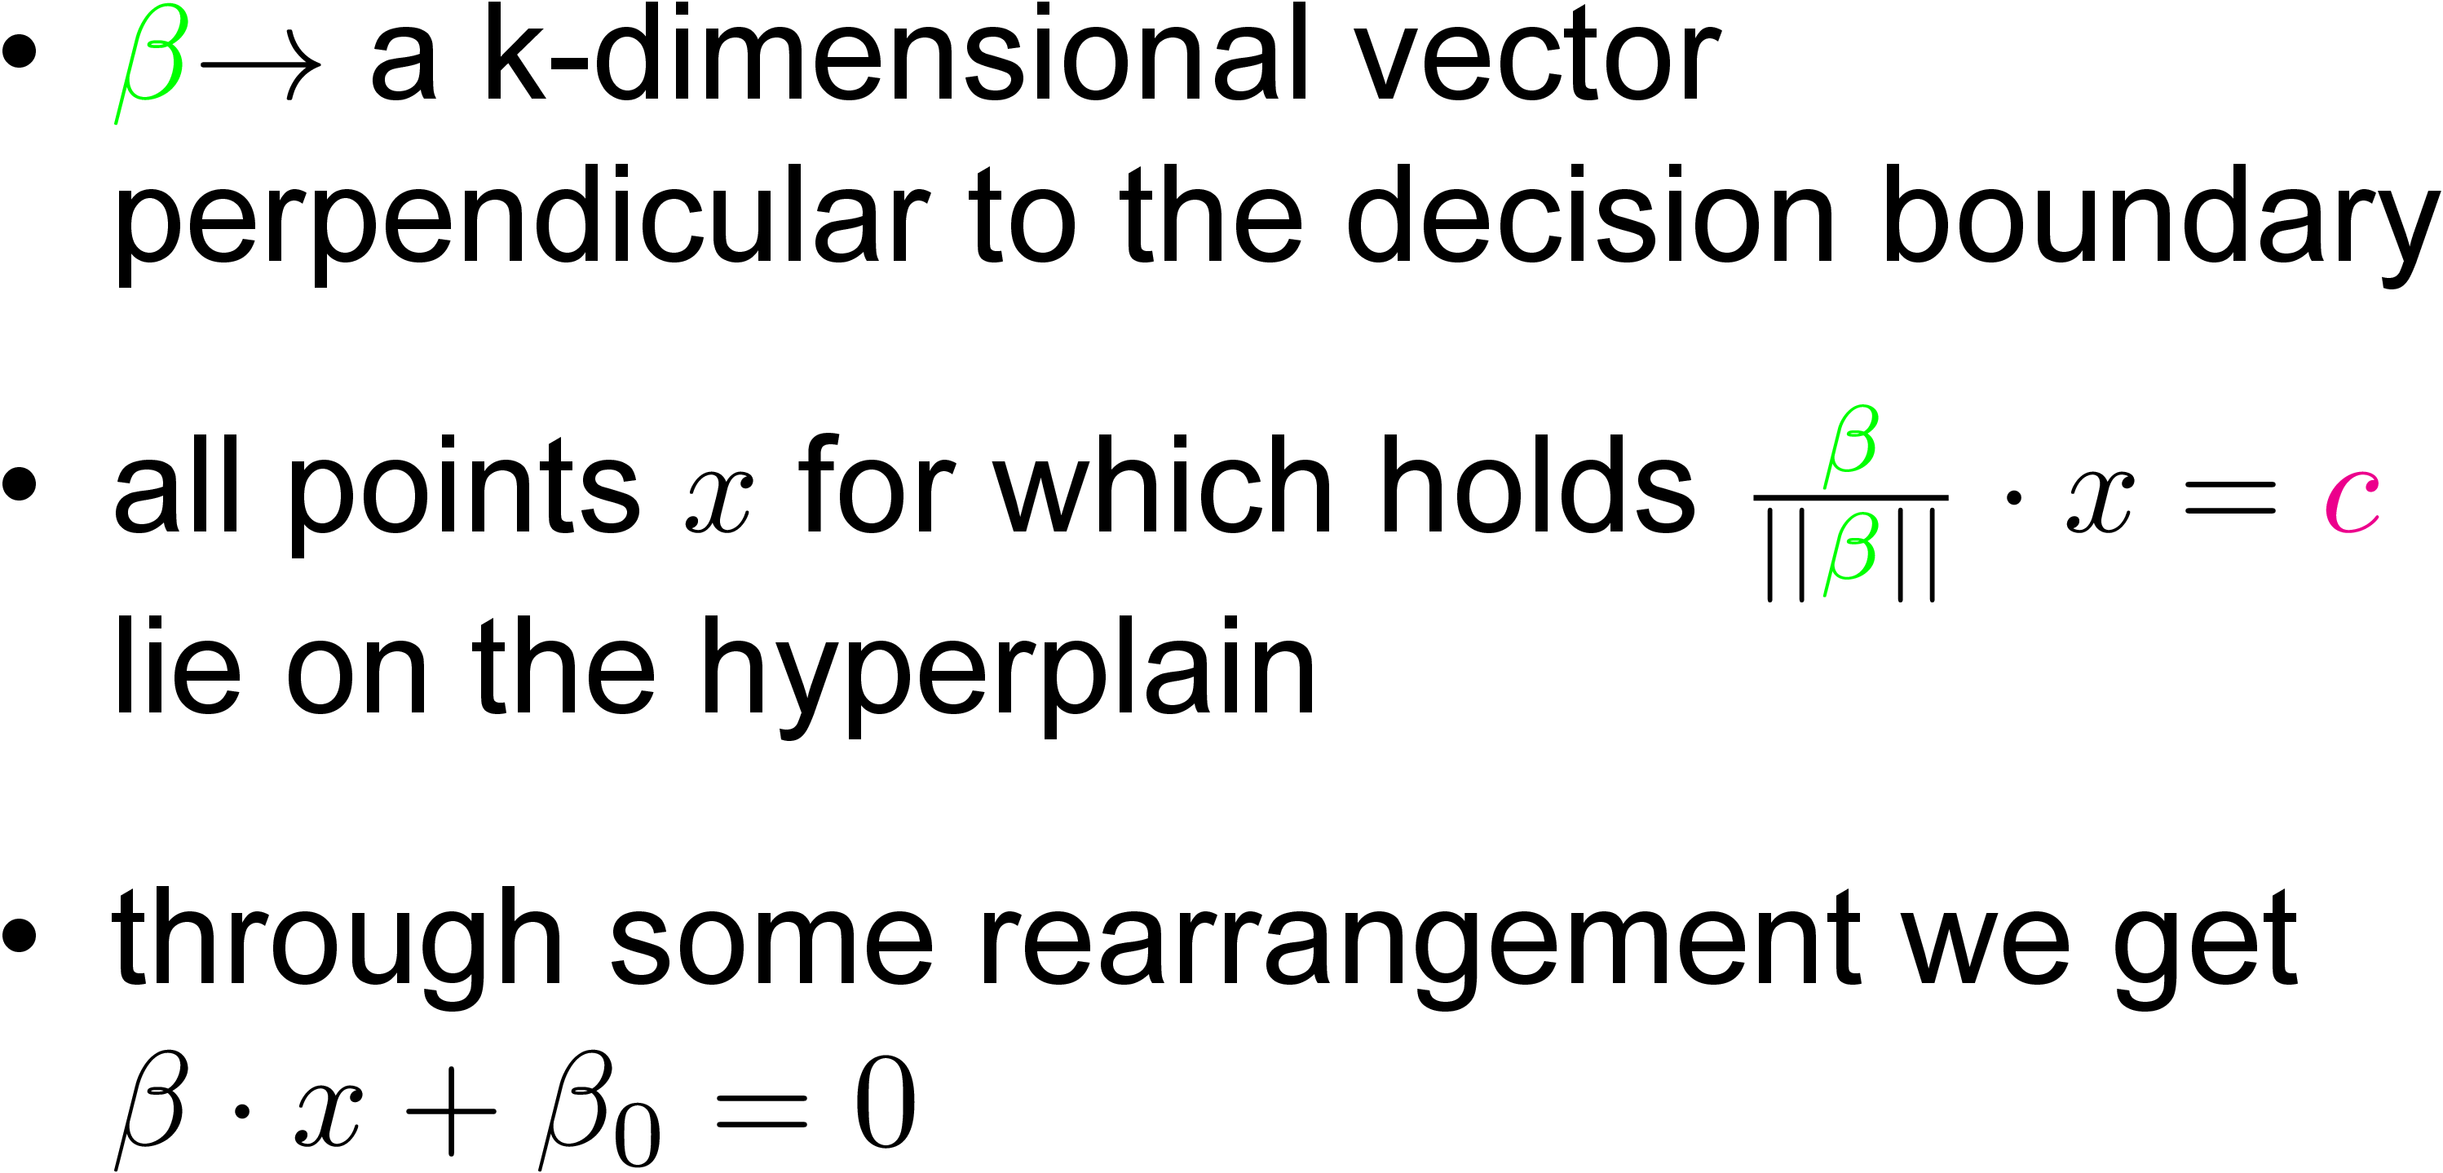
How it works: Setting up Constraints

Slide 7
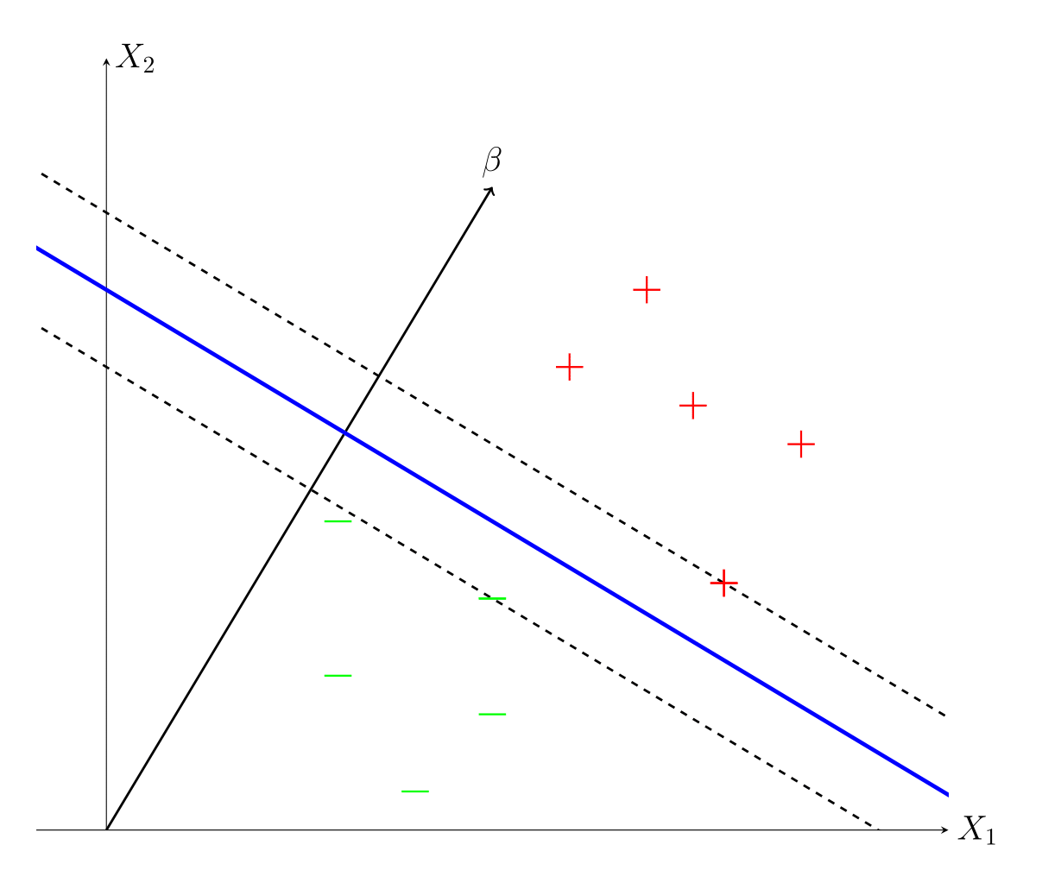
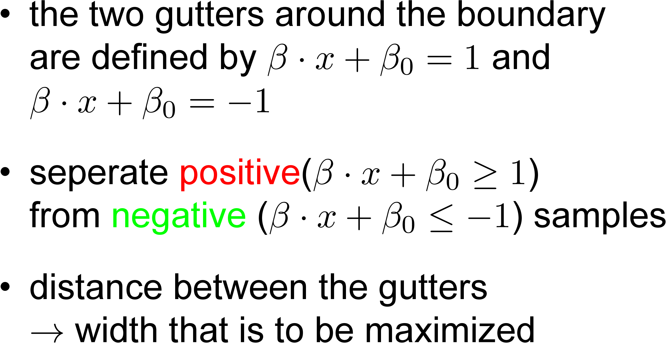
How it works: Setting up Constraints

Slide 8
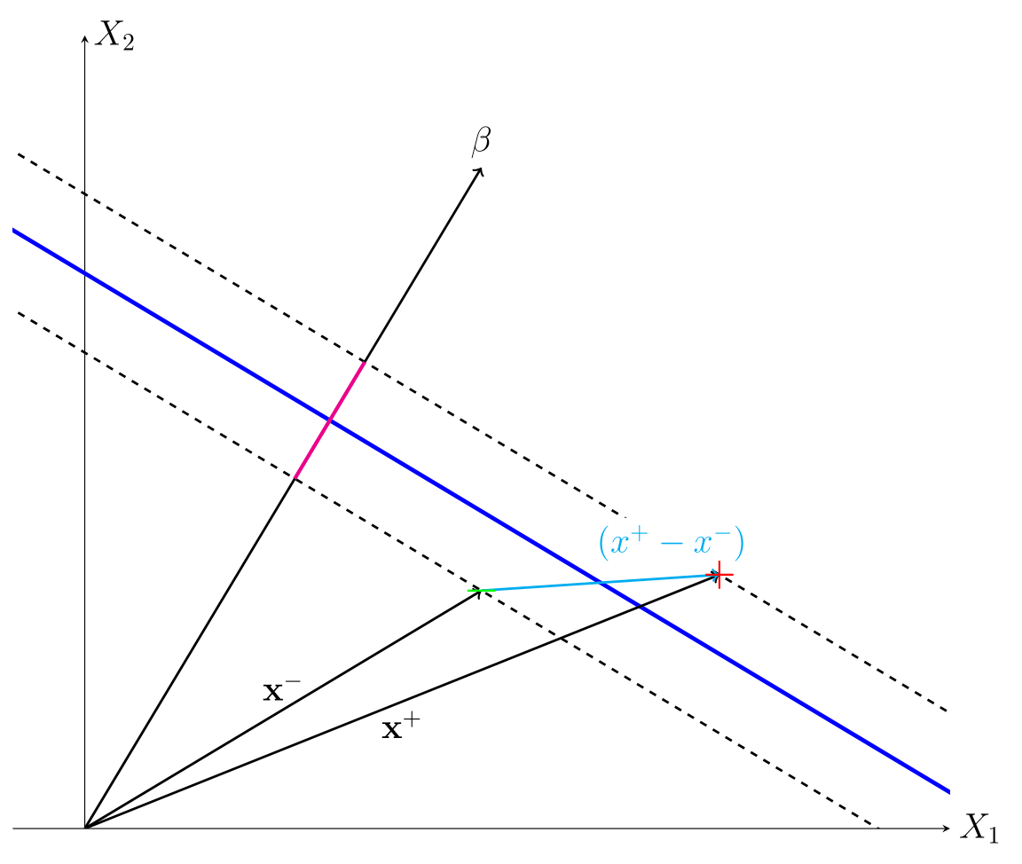
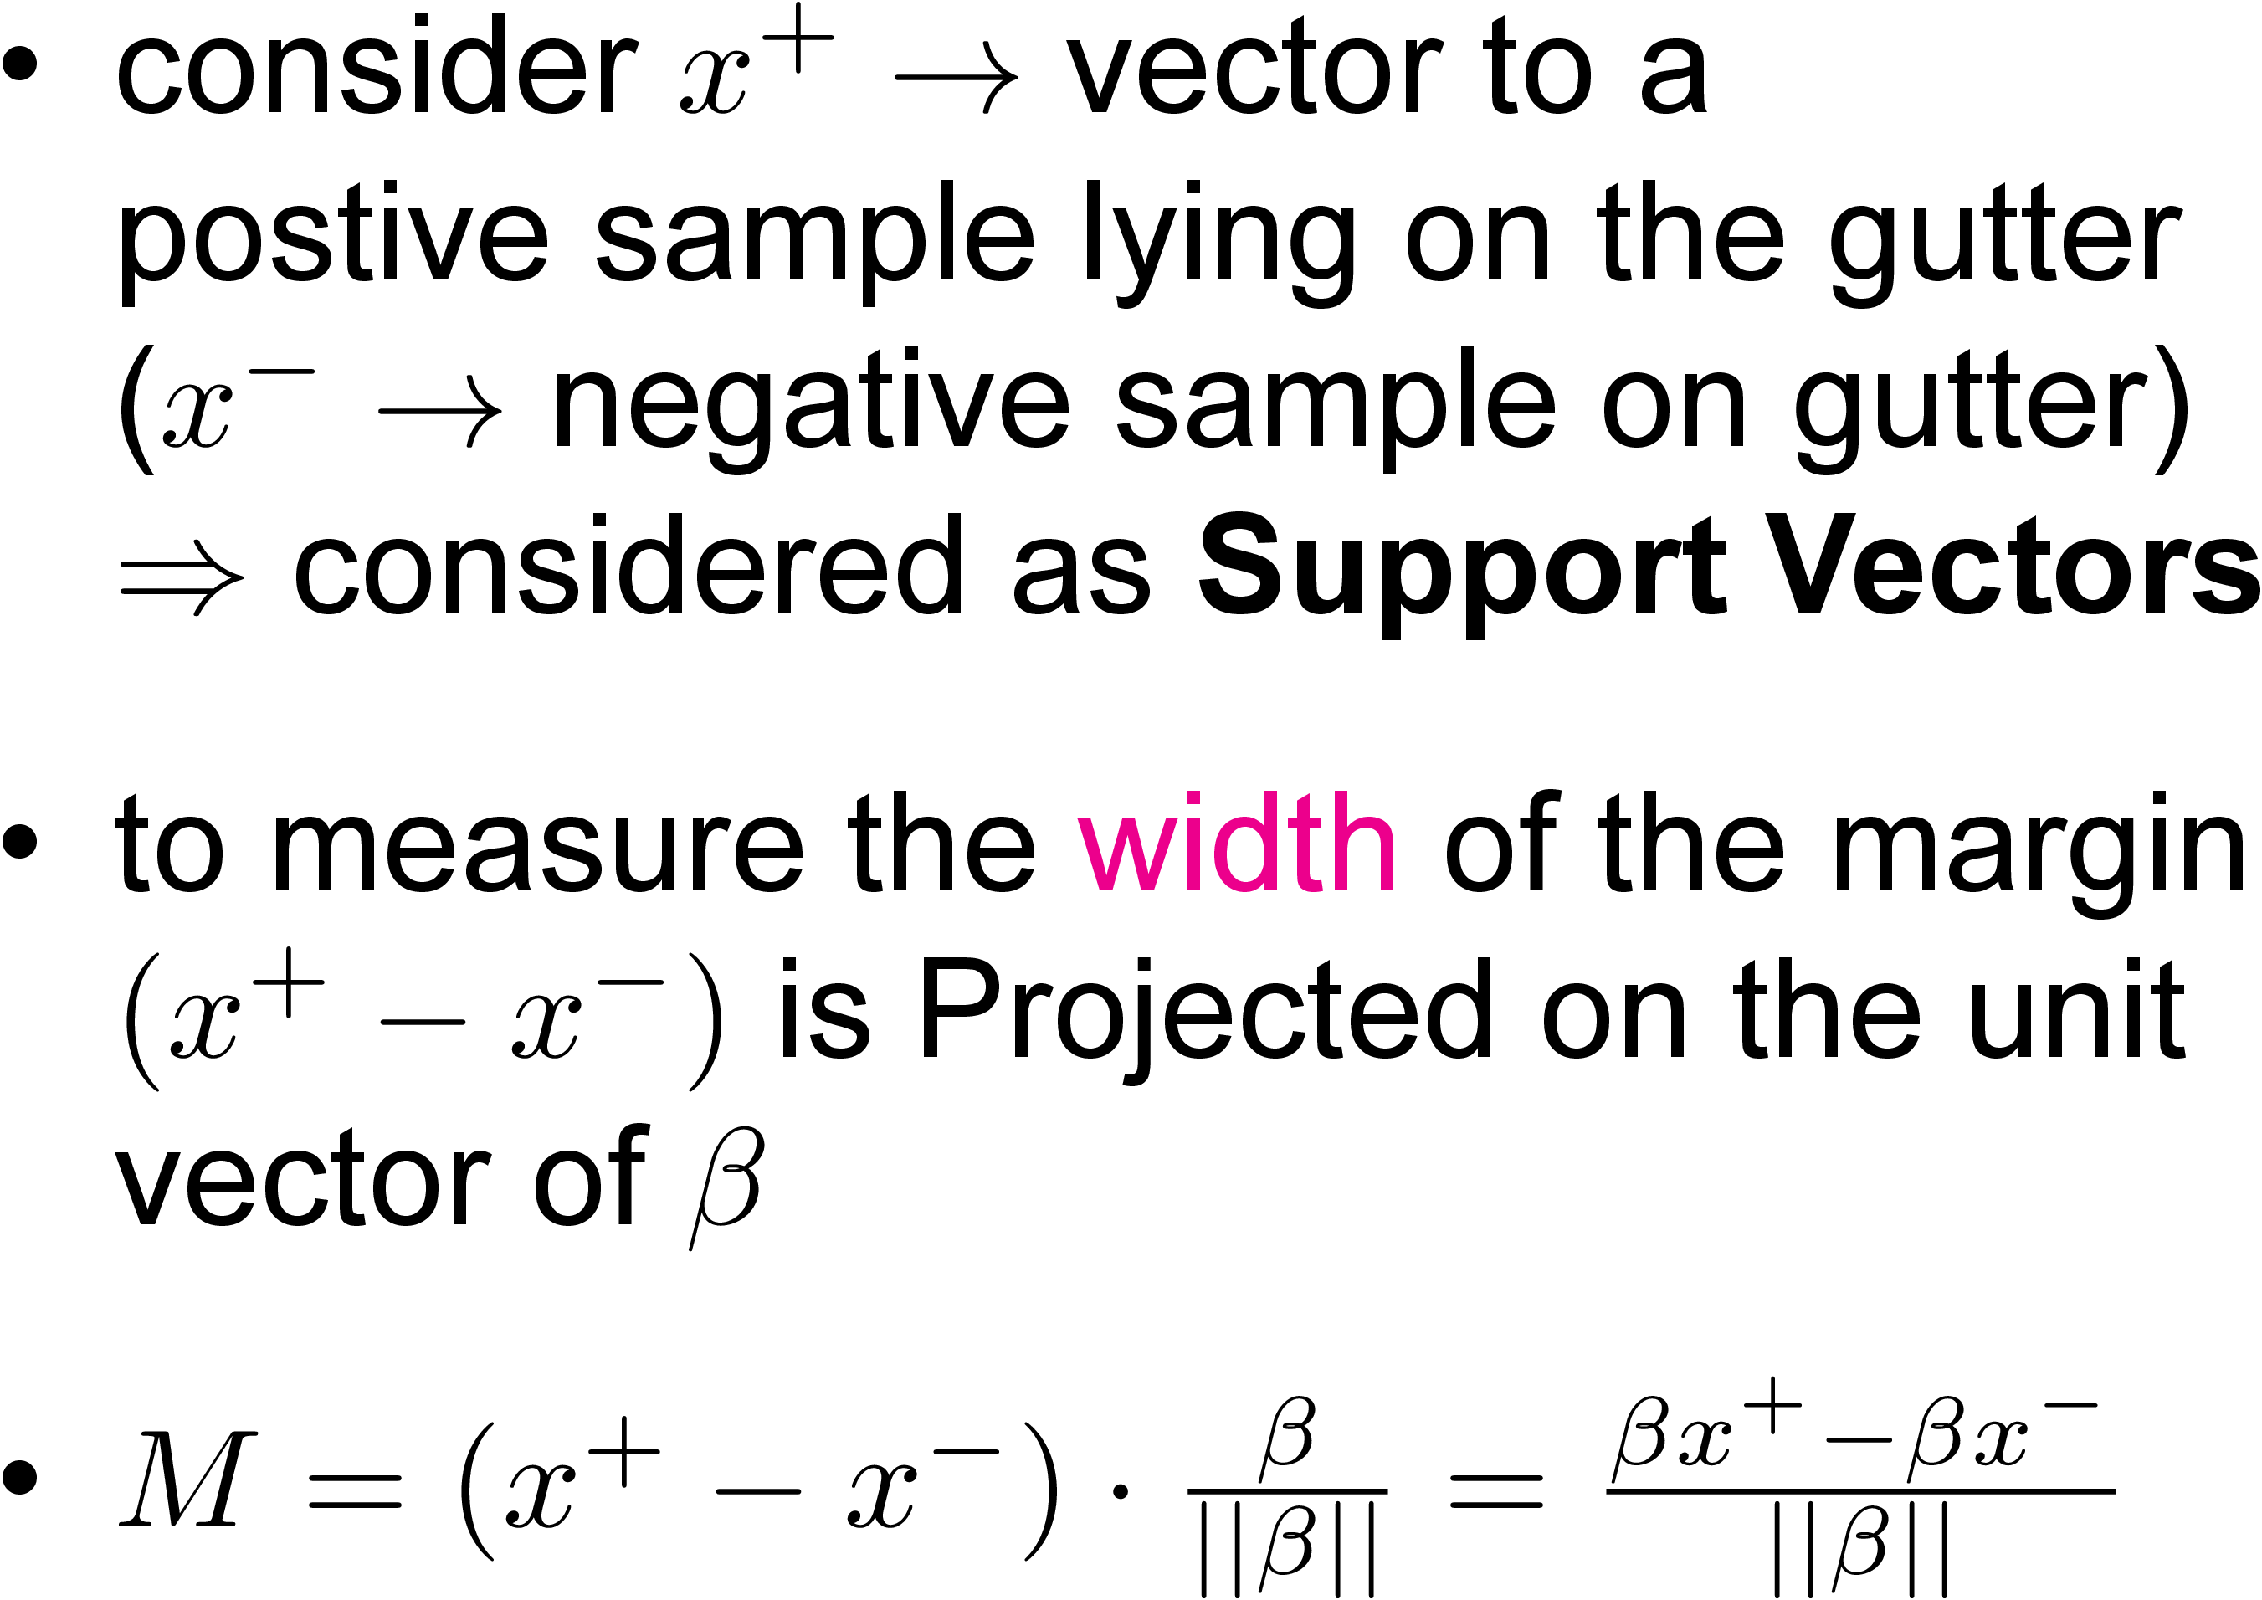
How it works: Setting up Constraints

Slide 9
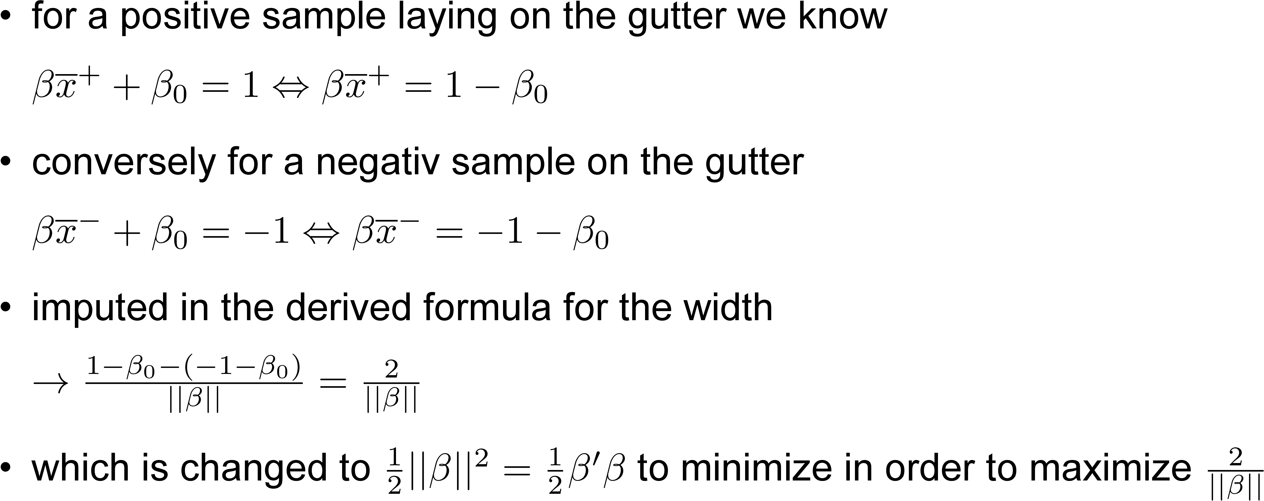
How it works: Setting up Constraints

Slide 10
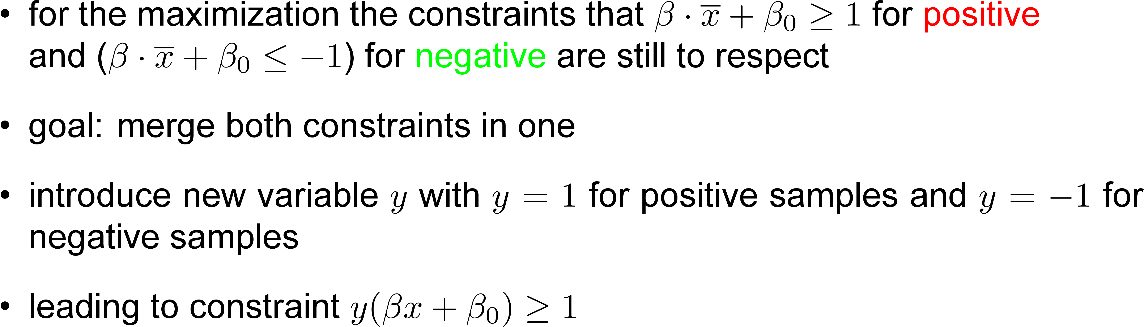
How it works: Setting up Constraints

Slide 11
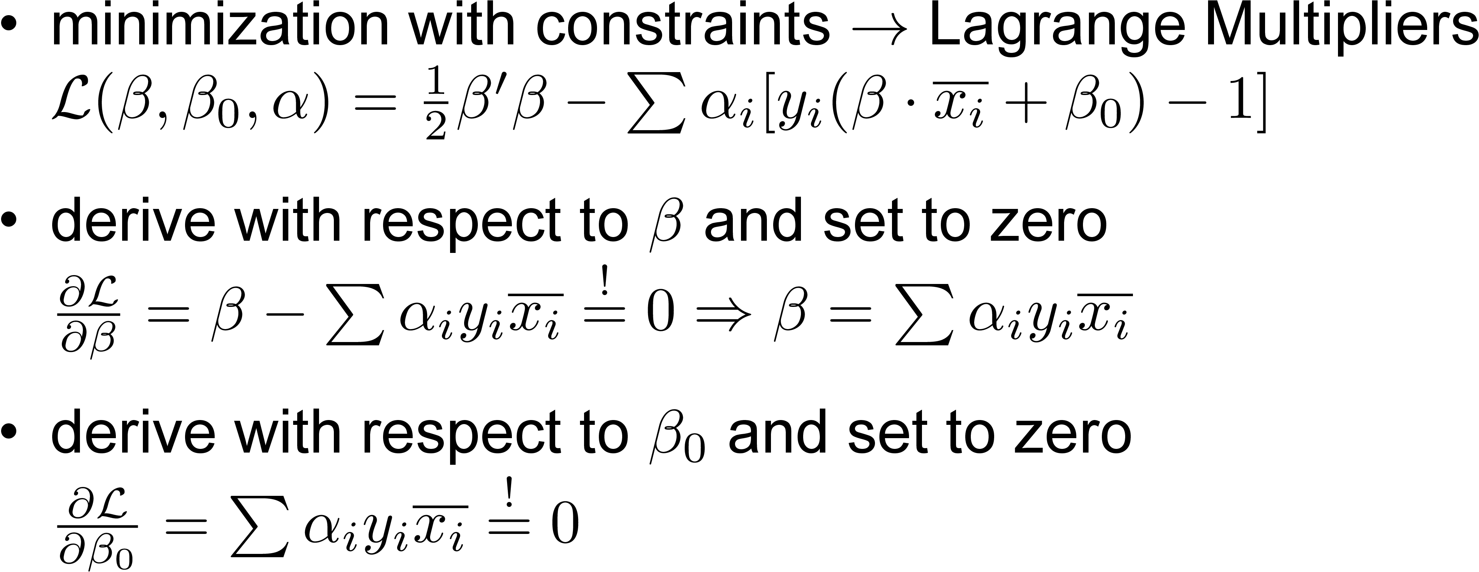
How it works: Maximization Process

Slide 12
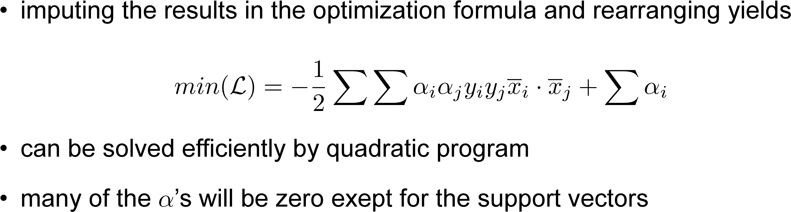
How it works: Maximization Process

Slide 13
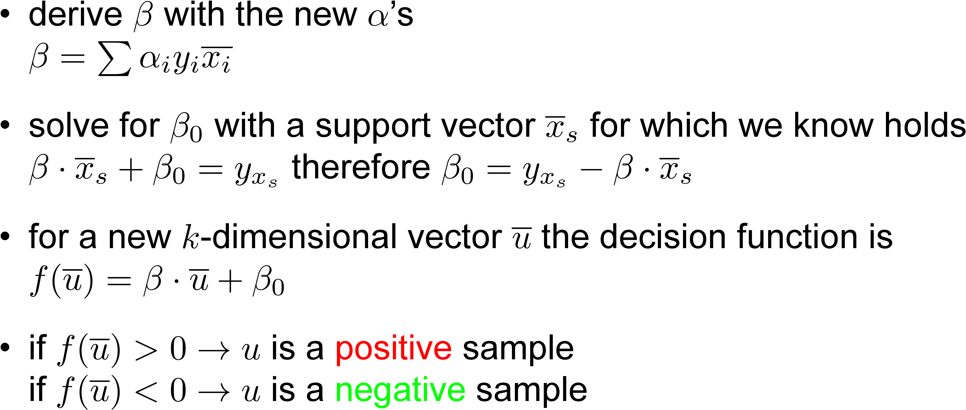
How it works: Decision Rule

Slide 14
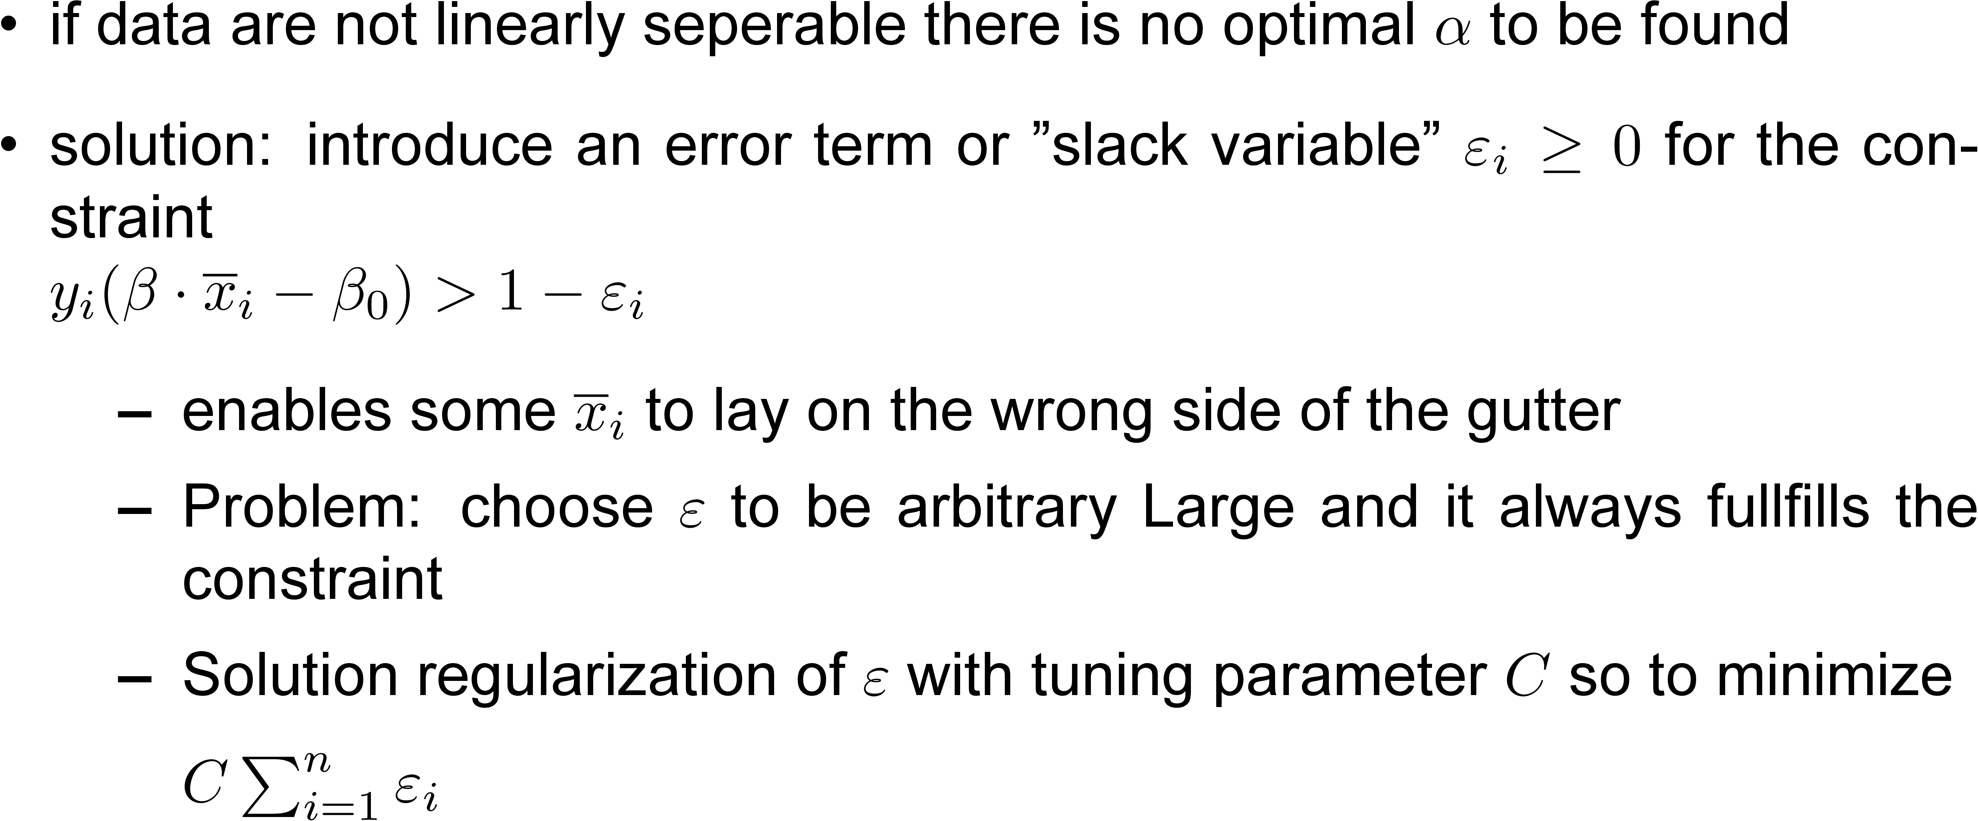
How it works: Soft Margin

Slide 15
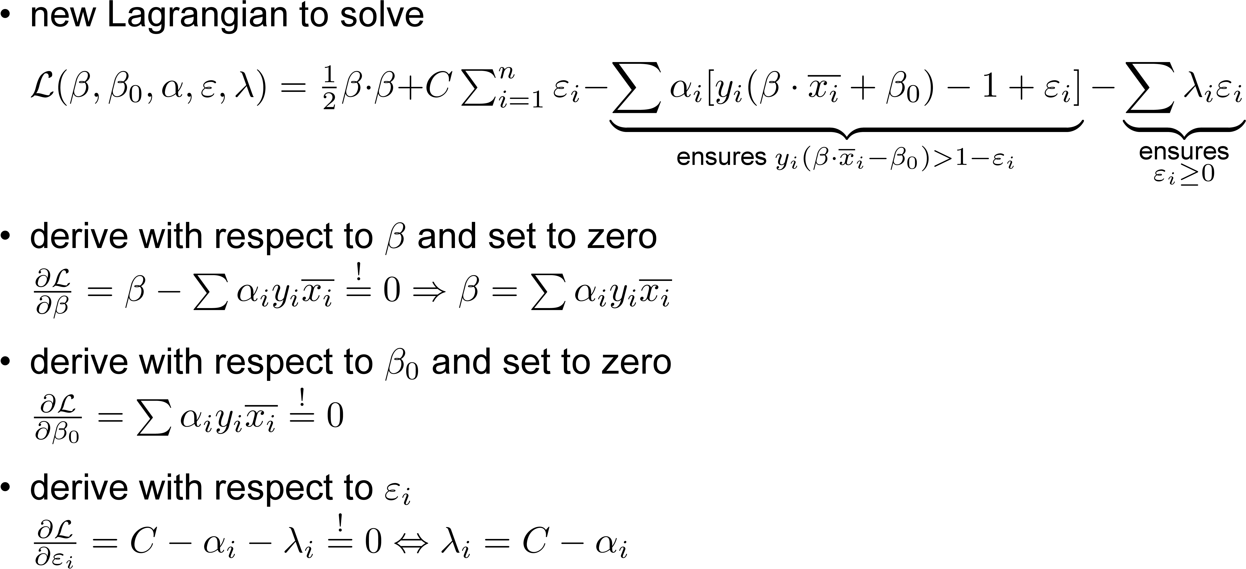
How it works: Soft Margin

Slide 16
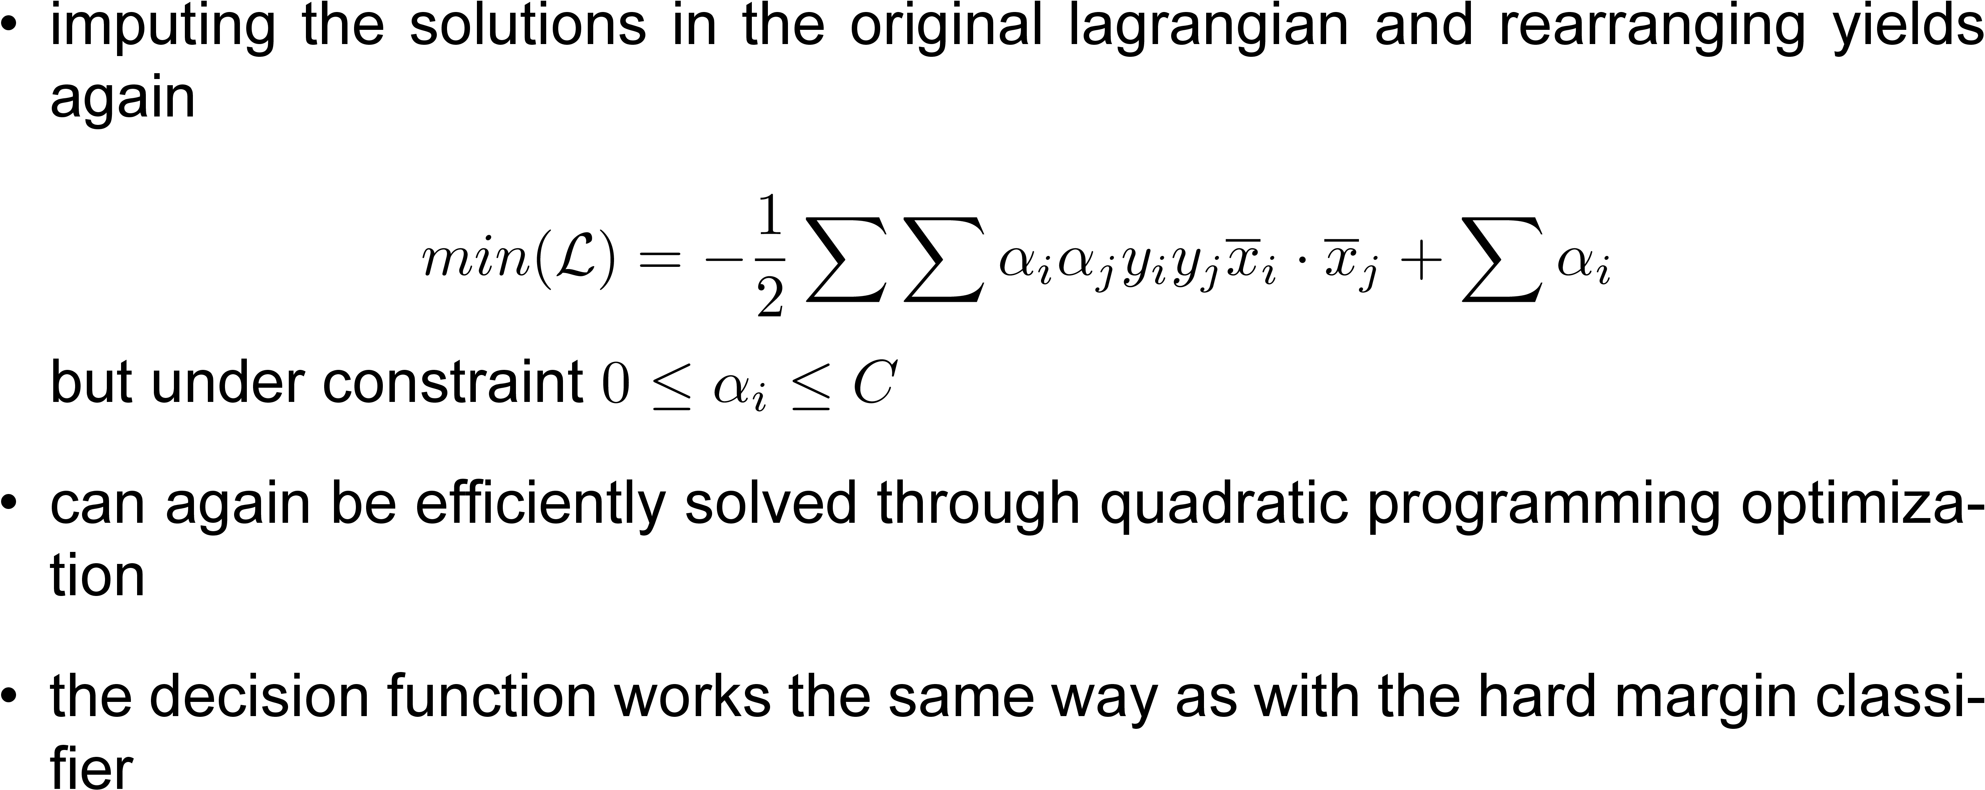
How it works: Soft Margin

Slide 17
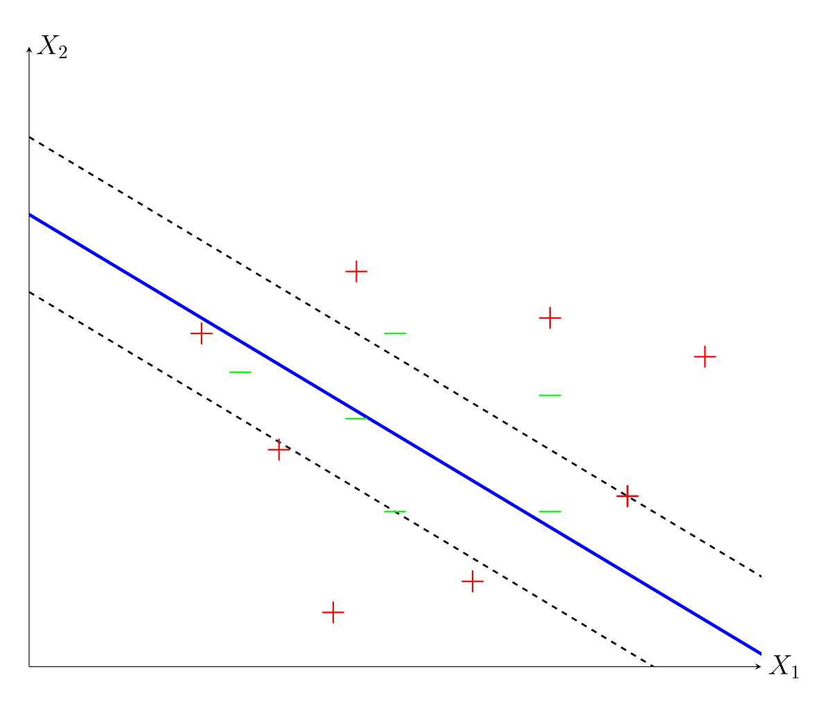
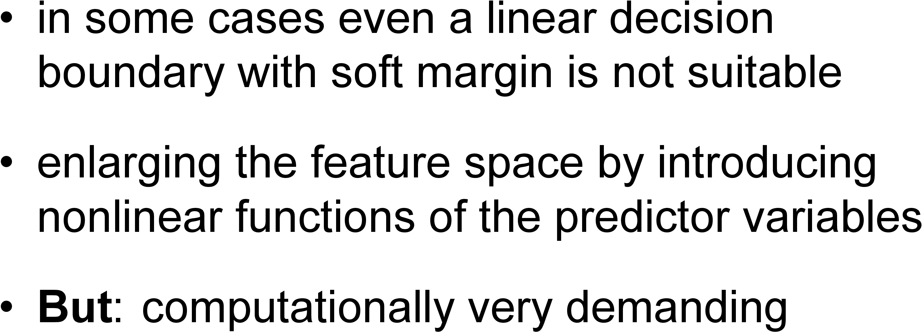
How it works: non linearity

Slide 18
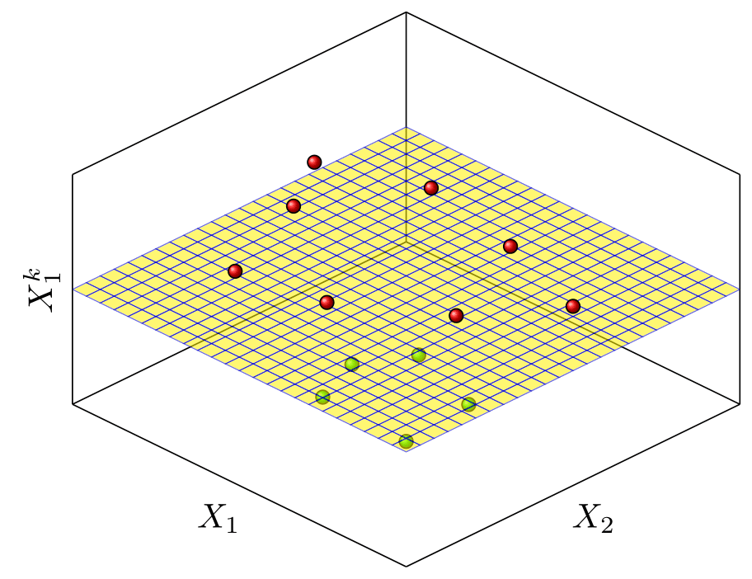
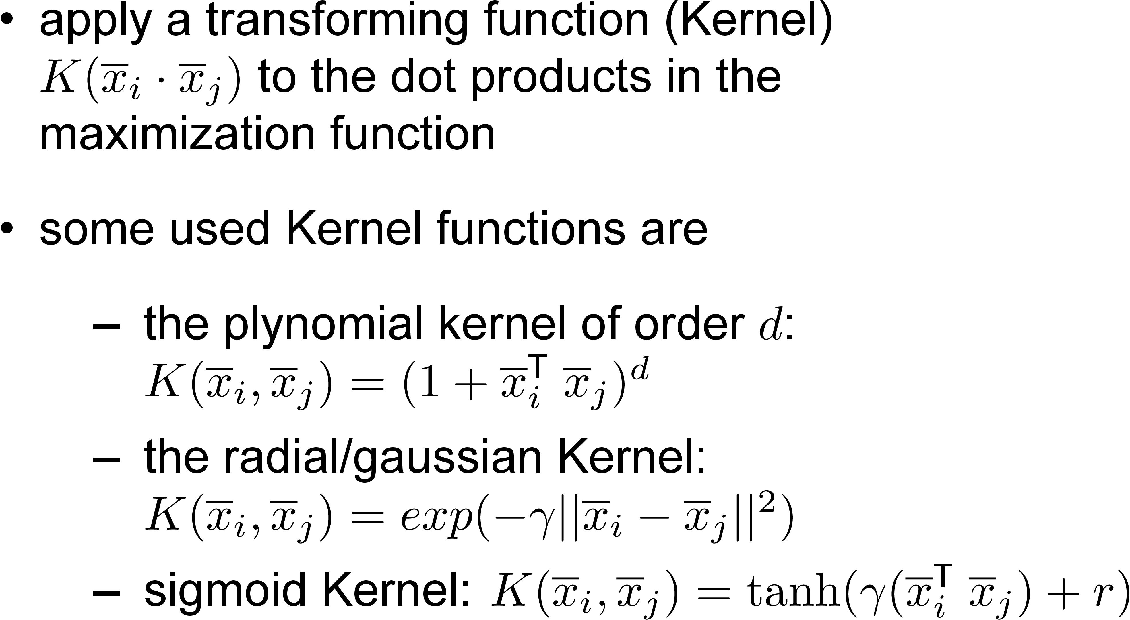
How it works: use of Kernels

Slide 19
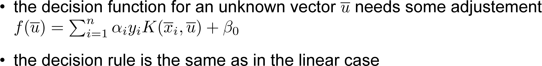
How it works: use of Kernels

Slide 20
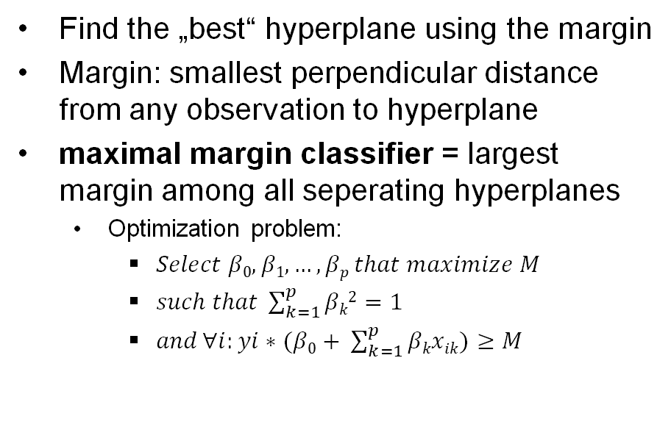
How it works: Maximal margin classifier
Find the „best“ hyperplane using the margin
Margin: smallest perpendicular distance from any observation to hyperplane
maximal margin classifier = largest margin among all seperating hyperplanes
Optimization problem:
$Select β0,β1,…,βp that maximize M$
$such that \sum_{k=1}^{p}{βk2=1}$
$and \text{∀}i:yi∗(β0+ \sum_{k=1}^{p}{βkxik)≥M}$
Grafik

Slide 21
Pros and Cons

Slide 22
How it works: Support vector machine

Slide 23
Dataset: ALLBUS
„General population survey of the social sciences“ (Allgemeine Bevölkerungsumfrage der Sozialwissenschaften)
Response Variable:
„Federal state where interviewee lived in youth“
coded to „Youth in East/West Germany“
Predictor Variables:
121 variables concerning attitudes, behavior and social change

Slide 24
Dataset: ALLBUS
Data Preparation:
Only include questions answered in all 3 Splits
Exclude questions with > 5% NA
Exclude observations with NA
After Preparation: 2509 observations and 122 variables

Slide 25
Simulation study
Measurement of accuracy:
Misclassification rate
ROC curve

Slide 26
Eventuell Vergleich zur logistischen Regression

